Slide 1
Smart Baby Bandage
Team Members :-
Sayali khare
George Samuels
Shardul virkar
Riya patel

Slide 2
INTRODUCTION
The purpose of the Smart Baby Bandage is to monitor the temperature and heart-rate of babies using a bandage which can be put on the baby.
It is targeted specifically for babies and hence the bandages will be available in the form of various popular cartoon characters.
It eliminates the cumbersome task of manually checking the temperature of the baby as the Smart Baby Bandage will keep providing real time temperature and heart-rate of the baby.
The app on the phone will also provide notifications to the parents when the temperature/heart-rate of the baby reaches dangerous levels.

Slide 3
REQUIRED MATERIAL
Lilypad
Wireless RF Transceiver
Bluetooth LE

Slide 4
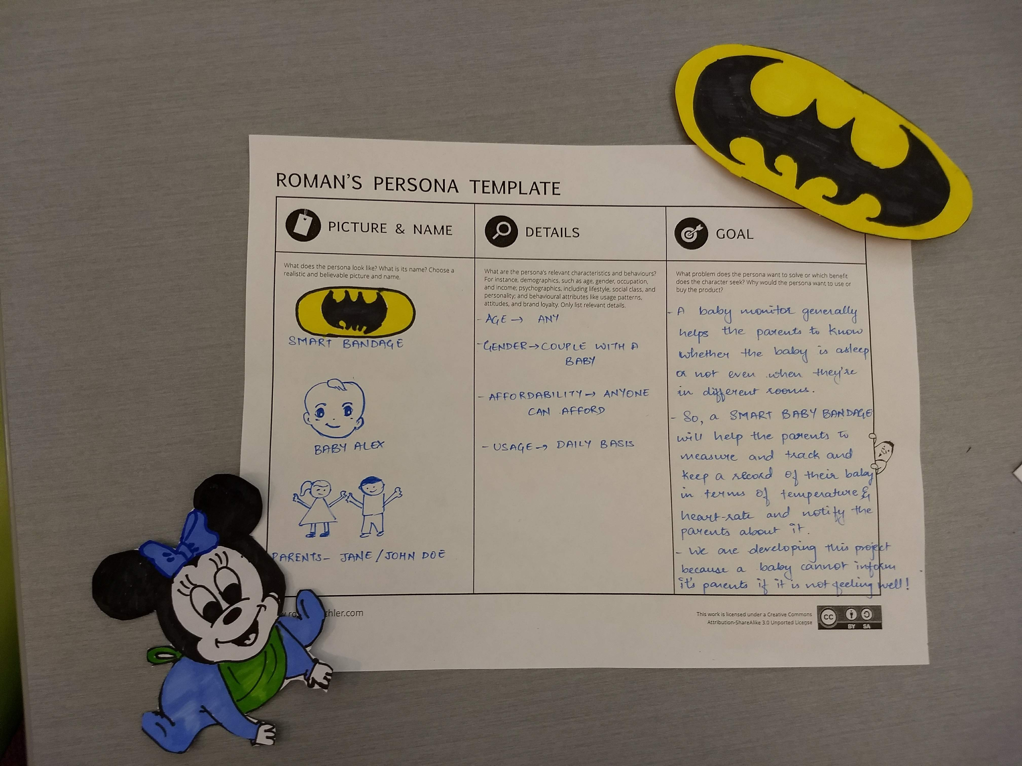
PERSONA

Slide 5
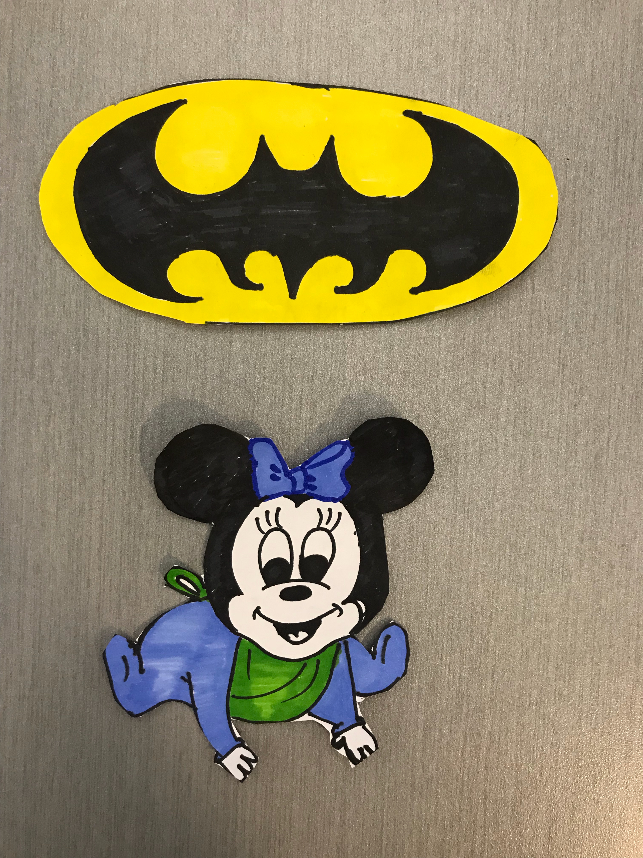
PROTOTYPE : SMART BANDAGE

Slide 6
BUSINESS PLAN
Lilypad with sensor thread : $50
Wireless RF Transceiver : $11
Bluetooth LE : $20

Slide 7
THANK YOU….

